Slide 1

Fine Tuning and RAG

Slide 2
Foundation Models and Fine-Tuning
What are Foundation Models?
Foundation models are large-scale AI models pre-trained on vast, diverse datasets. These models are designed to be highly generalizable, providing the base for a wide range of downstream tasks. Examples of foundation models include GPT-4, BERT, and CLIP. These models are versatile, capable of handling various data types such as text, images, and audio.
Fine-Tuning
Fine-tuning refers to the process of customizing a pre-trained foundation model for a specific task by training it on additional, domain-specific data. This approach allows organizations to adapt foundation models to their needs without the need for extensive retraining from scratch. For example, a general language model like GPT can be fine-tuned to better handle finance-related text, resulting in models like FinBERT.
Benefits of Fine-Tuning
Customization: Fine-tuning enhances the model’s performance for specific applications, making it more relevant for niche use cases.
Efficiency: It requires less computational power and data compared to training a model from scratch.
Scalability: Fine-tuned models can be deployed across various domains, from healthcare to finance and beyond.

Slide 3
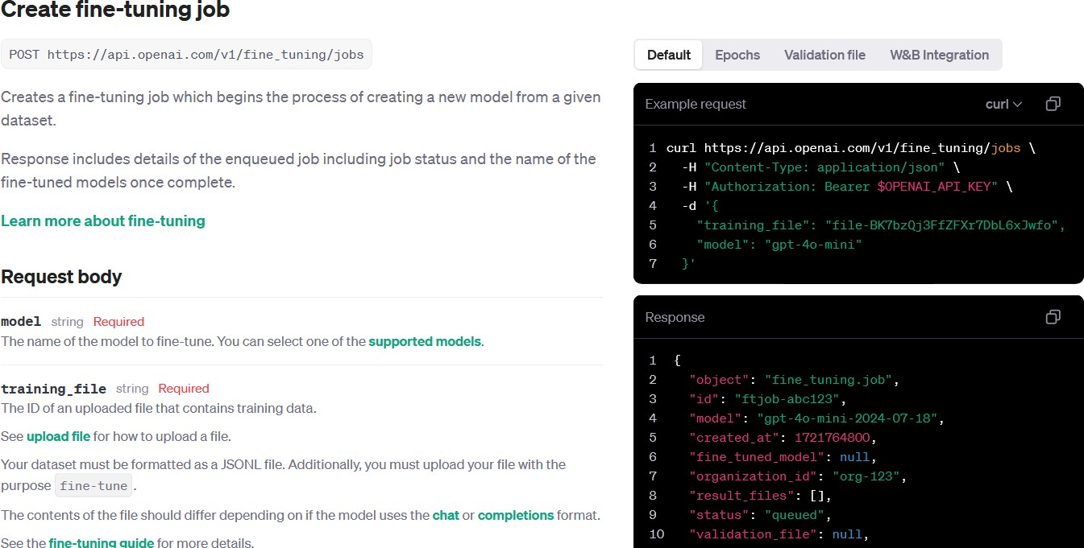
Fine-Tuning – Getting started
https://platform.openai.com/docs/api-reference/fine-tuning/create

Slide 4
Retrieval-Augmented Generation (RAG)
What is RAG?
Retrieval-Augmented Generation (RAG) enhances a language model's capabilities by allowing it to access external data sources in real-time. It works by retrieving relevant information from databases or other sources and combining it with the user's query to generate a more contextually accurate and up-to-date response. This is particularly useful when dealing with constantly evolving fields like healthcare or finance, where accessing the latest information is crucial.
RAG VS. Fine tuning
RAG differs from fine-tuning primarily in how each method handles information:
RAG dynamically retrieves external data from databases or APIs during inference, enabling the model to access and incorporate real-time, ensuring the generated responses are up-to-date. It doesn't alter the model's internal knowledge but enhances its answers with current, relevant data.
In contrast, fine-tuning involves retraining the model with a domain-specific dataset to embed specialized knowledge directly into the model itself. This means fine-tuned models provide consistent, specialized outputs but lack the ability to adapt to new or updated information without retraining. This permanently embeds domain-specific knowledge within the model, making it more adept at particular tasks but unable to incorporate new information unless retrained

Slide 5
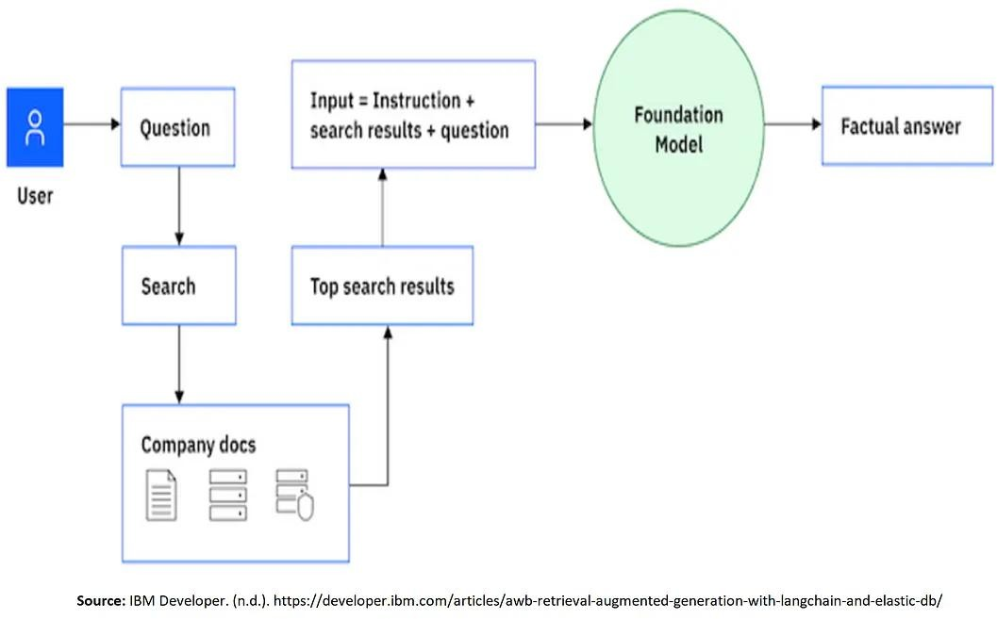
Retrieval-Augmented Generation (RAG) – Cont.

Slide 6
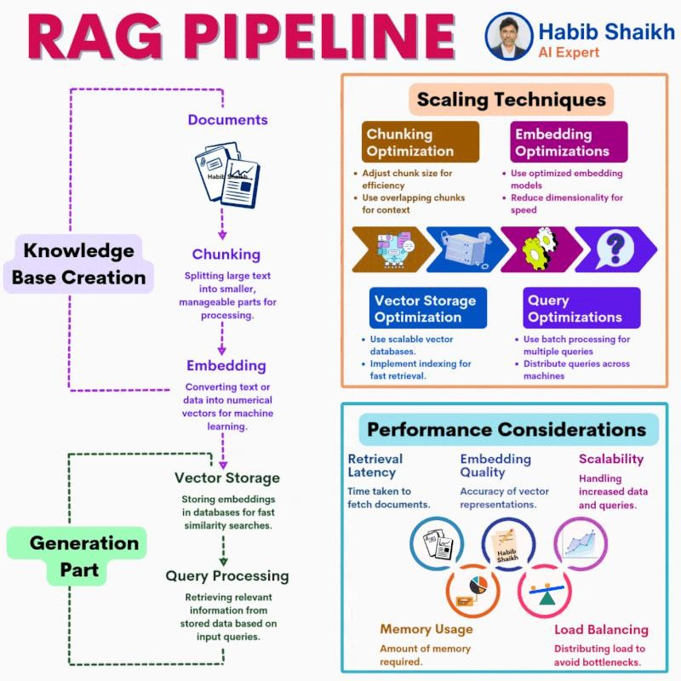
RAG data pipeline flow
High-level flow for a data pipeline that supplies grounding data for a RAG application:
Documents are either pushed or pulled into a data pipeline.
The data pipeline processes each document individually by completing the following steps:
Chunk document: Breaks down the document into semantically relevant parts that ideally have a single idea or concept.
Enrich chunks: Adds metadata fields that the pipeline creates based on the content in the chunks. The data pipeline categorizes the metadata into discrete fields, such as title, summary, and keywords.
Embed chunks: Uses an embedding model to
vectorize the chunk and any other metadata fields that are used for vector searches.
Persist chunks: Stores the chunks in the search index.
General

Slide 7
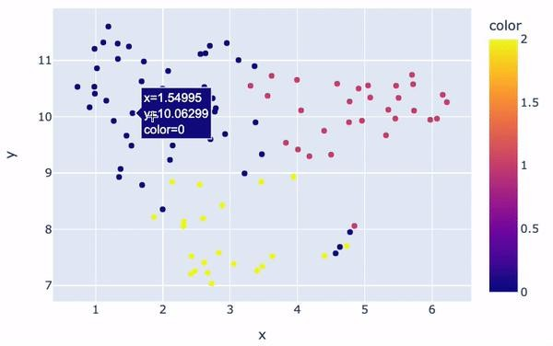
RAG – Embeddings
Embeddings are a way to represent words, sentences, or even entire
documents as dense vectors in a high-dimensional space.
An embedding is a mathematical representation of an object, such as text. When a neural network is being trained, many representations of an object are created. Each representation has connections to other objects in the network.
The purpose of embeddings is to capture the semantic meaning of text, such that words or phrases with similar meanings are located closer to each other in this vector space.
For example:
The words “king” and “queen” might be close to each other in an
embedding space because they share similar semantics (both are royalty).
Embedding similarity: the distance between any two items can be calculated mathematically and can be interpreted as a measure of relative similarity between those two items.
The AI model is trained in such a way that these vectors capture the essential features and characteristics of the underlying data.

Slide 8
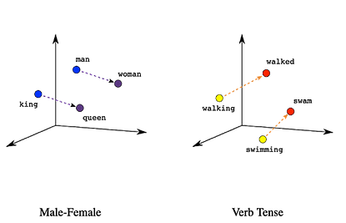
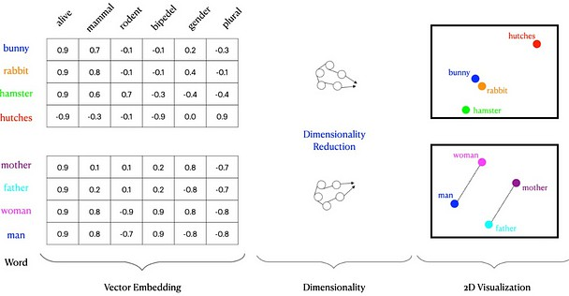
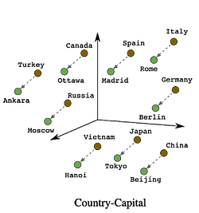
RAG – Embeddings (Cont.)

Slide 9
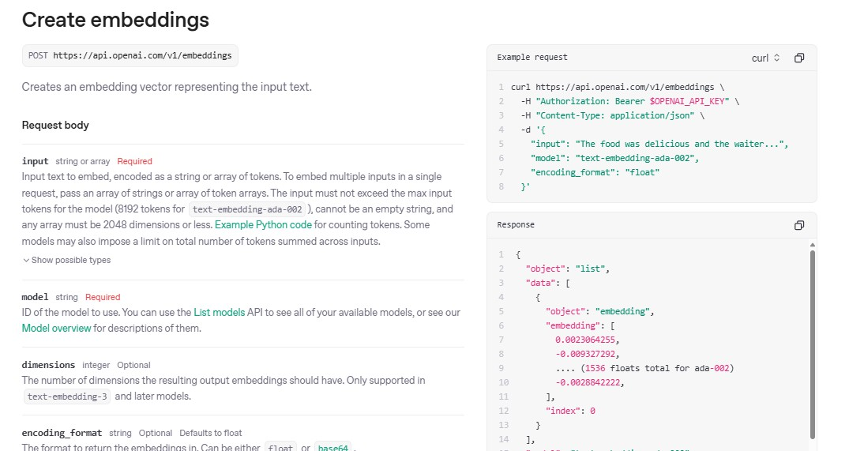
RAG – Creating Embeddings
API Reference - OpenAI API

Slide 10
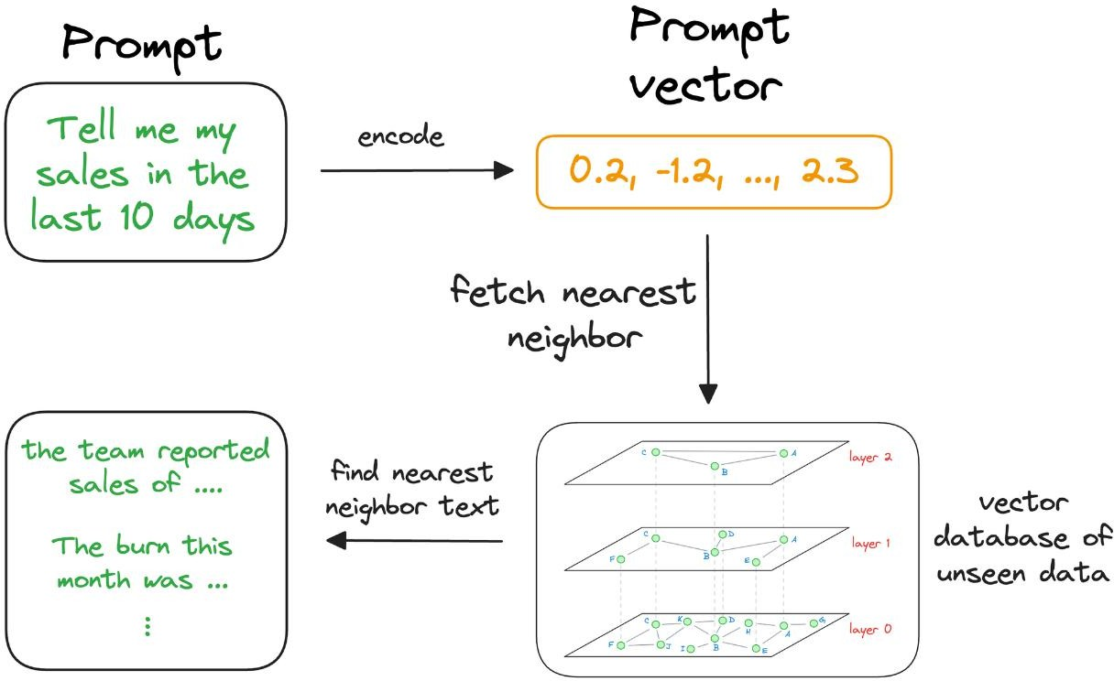
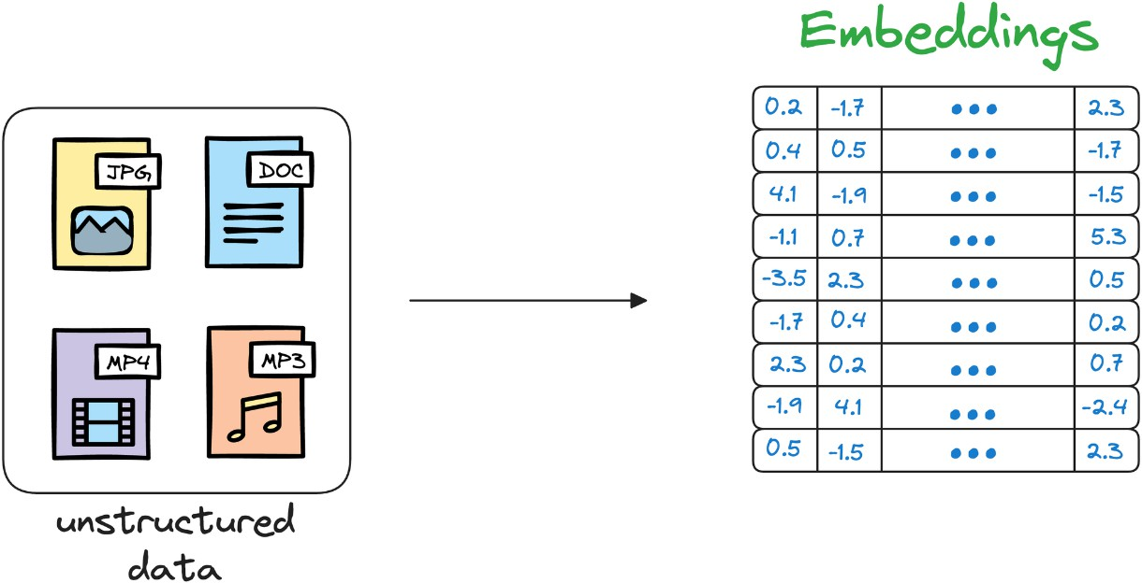
RAG – Vector databases
Vector database stores unstructured data (text, images, audio, video, etc.) in the form of vector embeddings.
Each data point, whether a word, a document, an image, or any other entity, is transformed into a numerical vector using ML techniques.

Slide 11
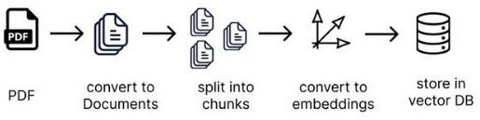
RAG – Putting all together

Slide 12
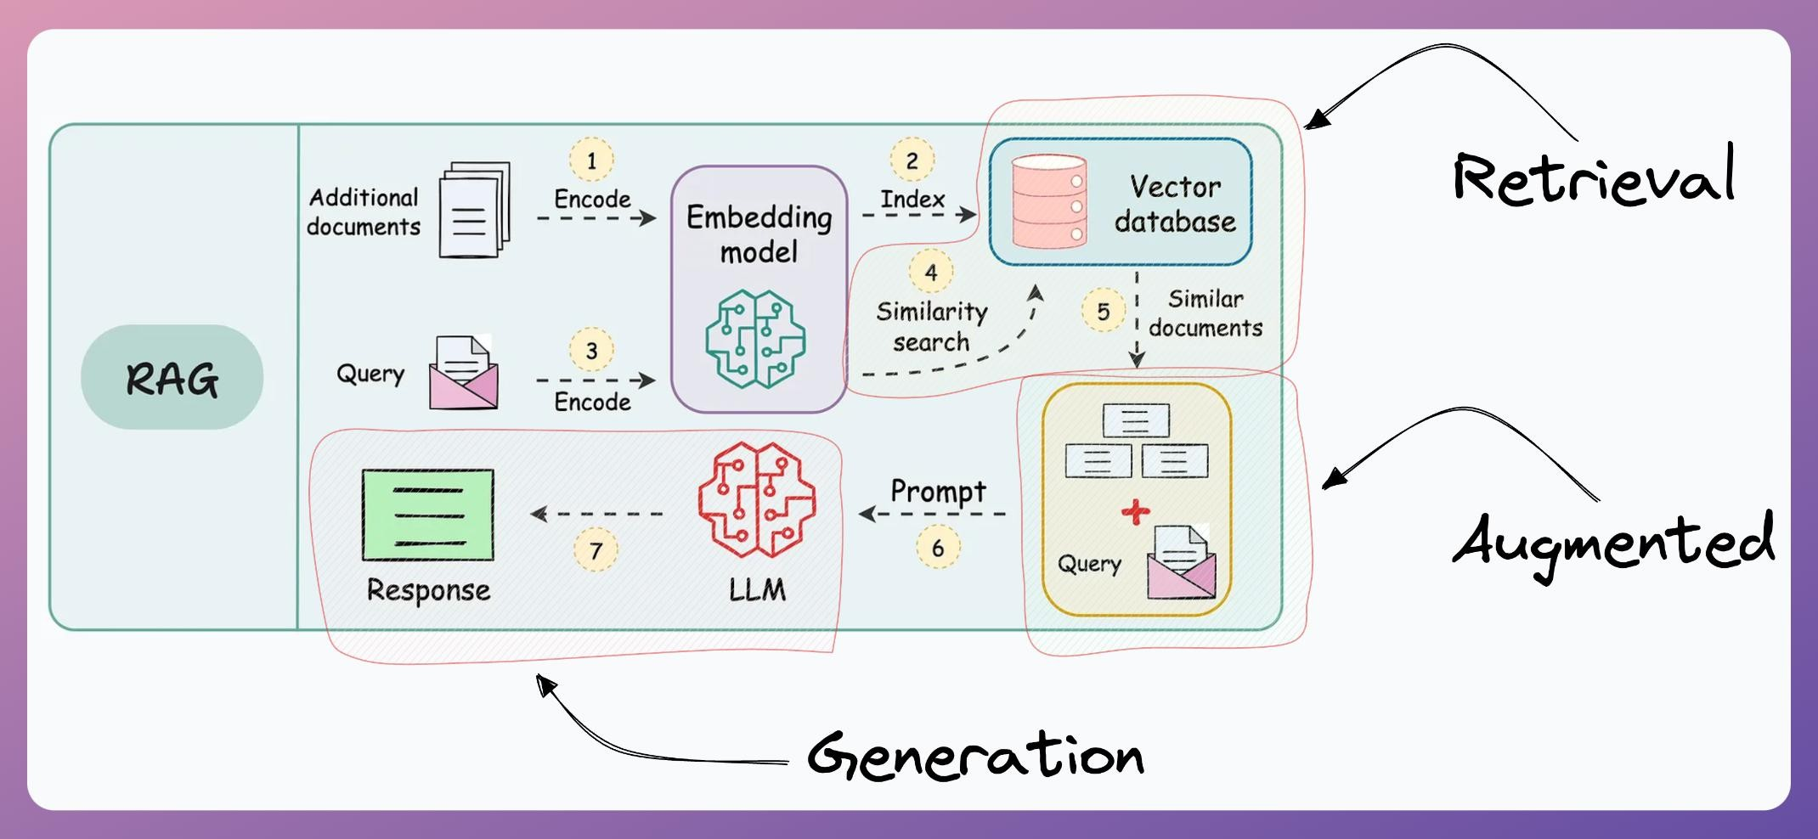
RAG re-represented
15

Slide 13
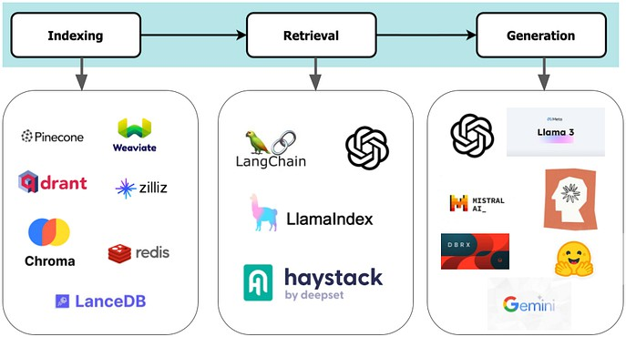
RAG developer’ stack

Slide 14
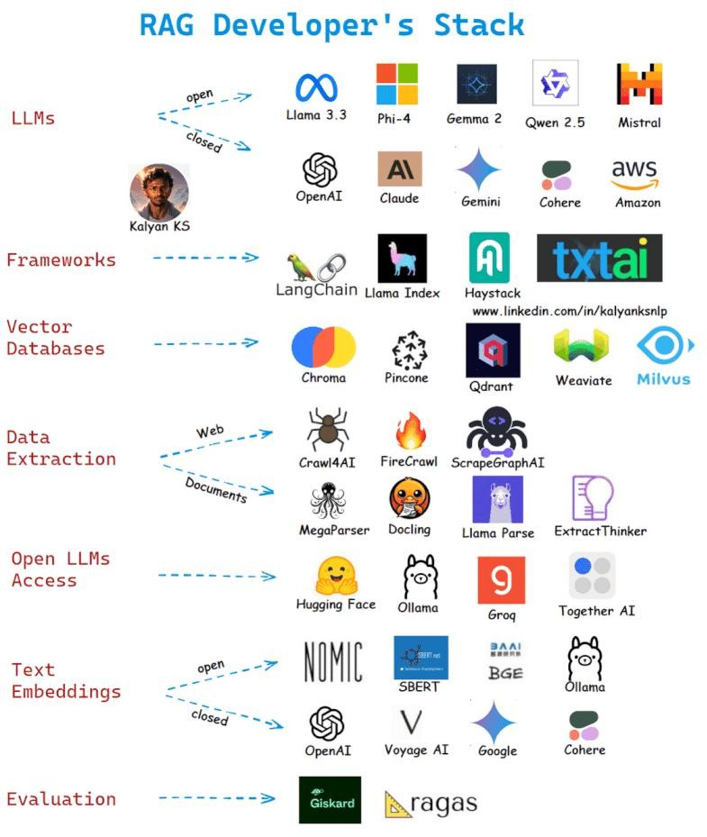
RAG developer’ stack

Slide 15
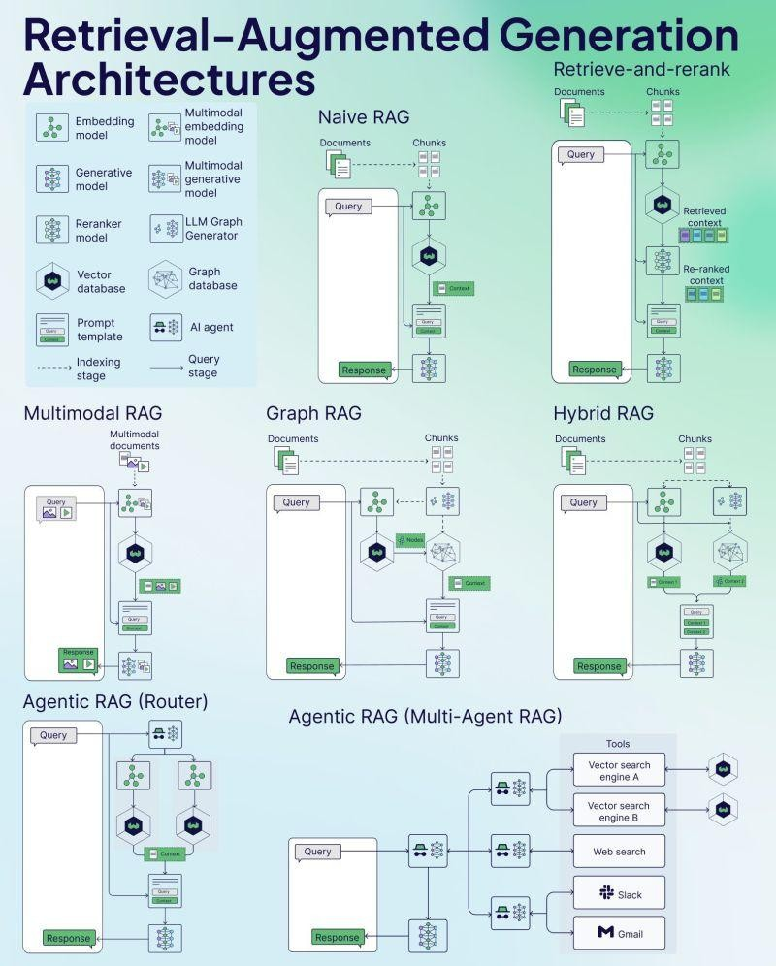
RAG Architectures

Slide 16
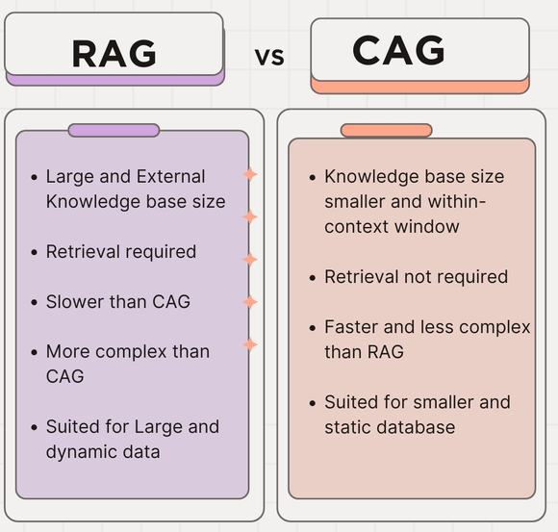
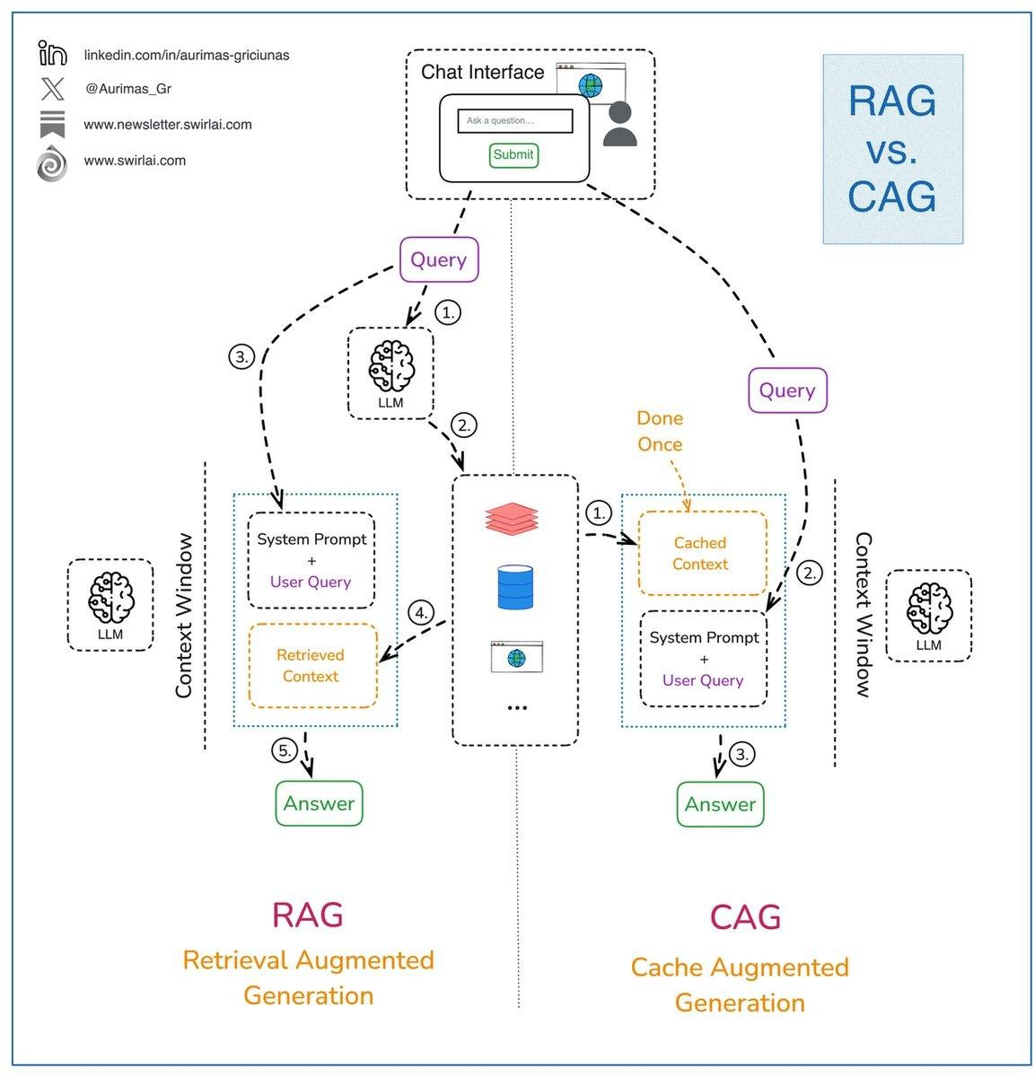
Cache-Augmented Generation (CAG)
19

Slide 17
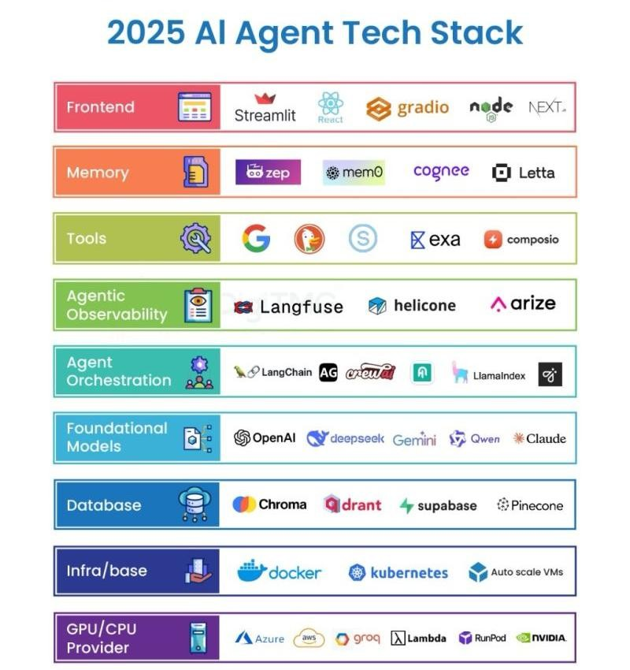
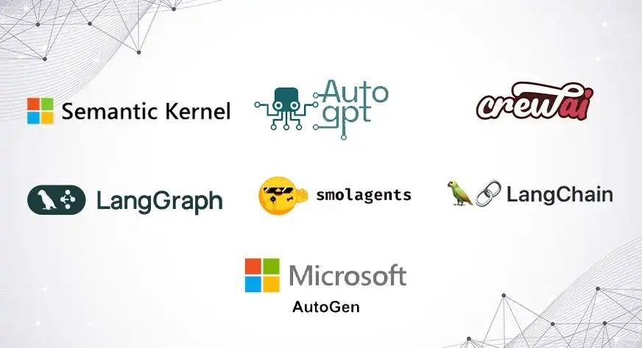
Agentic frameworks
https://www.ibm.com/think/insights/top-ai-agent-frameworks

Slide 18
Other Links
Apriora video Link: https://www.youtube.com/watch?v=cyCsNKhba0U
To Create RAG System : DeepLearning.AI

Slide 19
Thank You

